Slide 1
U-SMC 2021-05-20

Slide 2

x1角度 x2角速度
$\dot{x_{1}}=x_{2}$
$\dot{x_{2}}=M^{−1}\left(u−Cx_{2}−G\right)$
U-model 控制量：
$u=M\ddot{z_{d}}+Cx_{2}+G$ 其中$\ddot{z_{d}}$是期望加速度
Invariant Plant:
$\frac{Y\left(S\right)}{R\left(S\right)}=G\left(S\right)=\frac{4}{s^{2}+4s+4}$

Slide 3
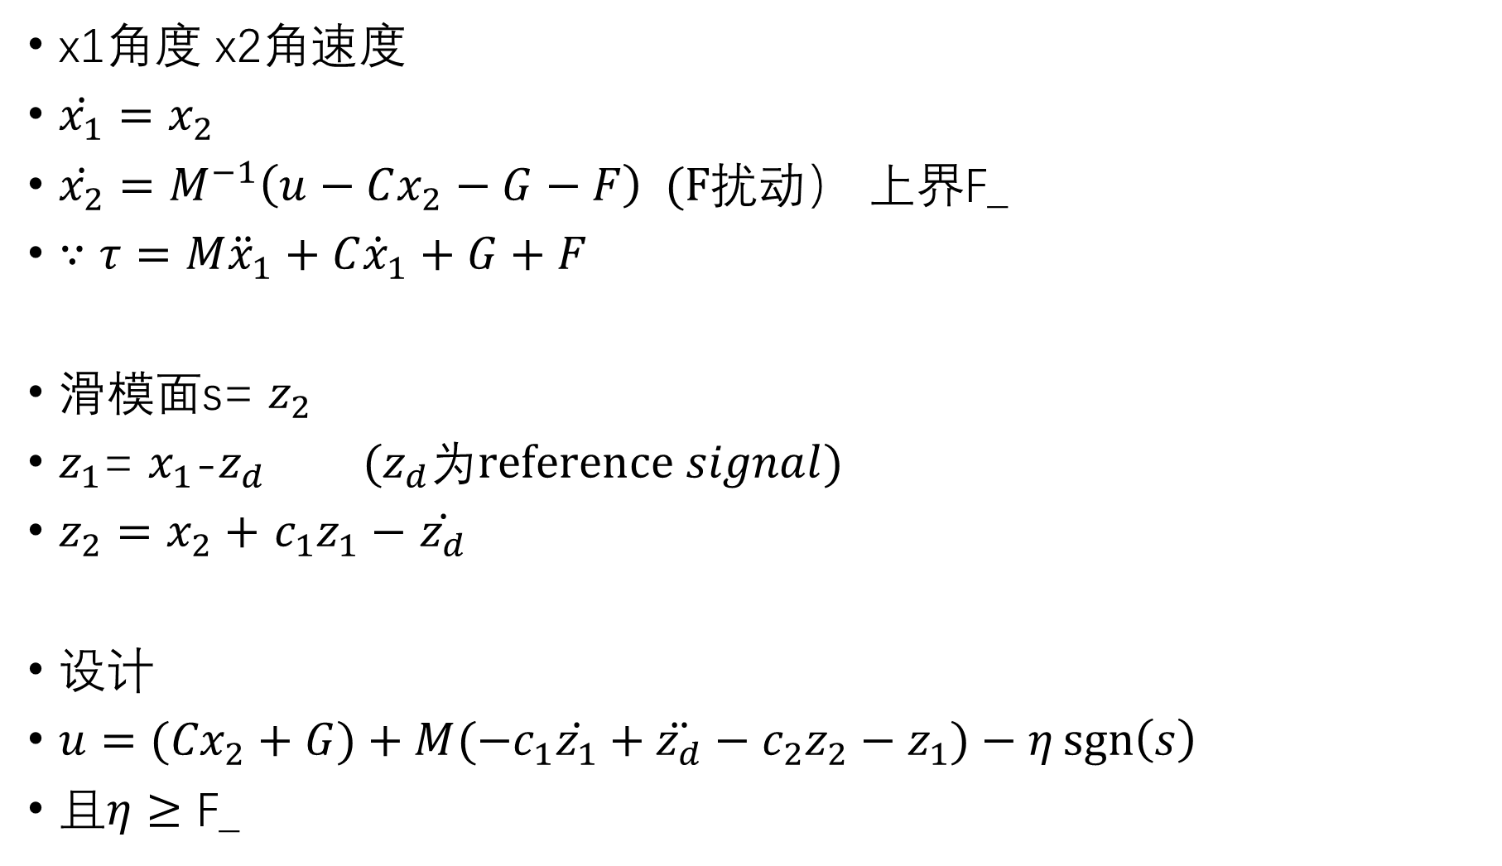
x1角度 x2角速度
$\dot{x_{1}}=x_{2}$
$\dot{x_{2}}=M^{−1}\left(u−Cx_{2}−G−F\right) (F扰动$） 上界F_
$∵τ=M{\ddot{x}}_{1}+C{\dot{x}}_{1}+G+F$
滑模面s= $z_{2}$
$z_{1}$= $x_{1}$-$z_{d} {(z}_{d}为reference signal)$
$z_{2}=$ $x_{2}+$ $c_{1}z_{1}−$ $\dot{z_{d}}$
设计
${u=(Cx}_{2}+G)+M(−c_{1}\dot{z_{1}}+\ddot{z_{d}}−c_{2}z_{2}−z_{1})−η\operatorname{sgn}\left(s\right)$
且$η≥\text{F}\text{_}$

Slide 4
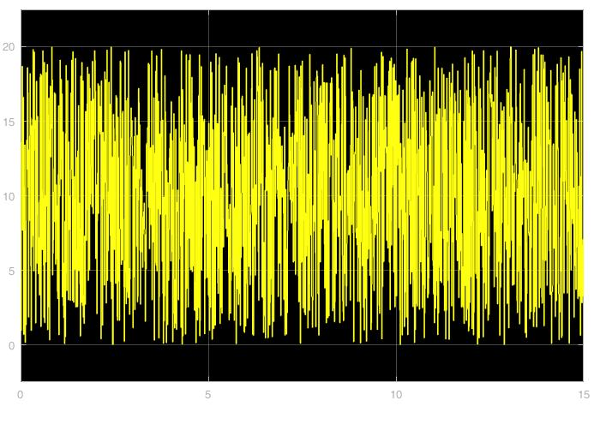

选取$η$=20 c1=10 c2=10 扰动F为幅值10的随机数
Reference signal: step input
仿真时间15s，sampling time 0.001s
Fig. disturbance

Slide 5
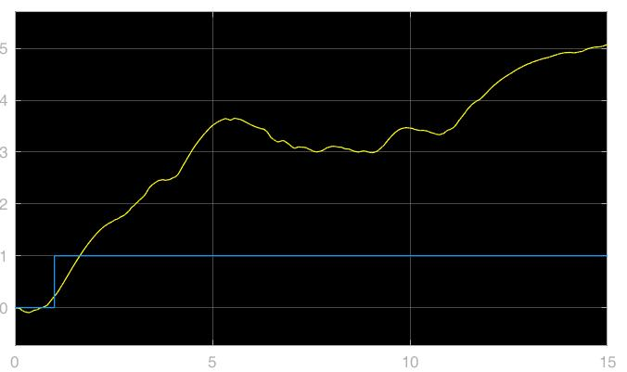
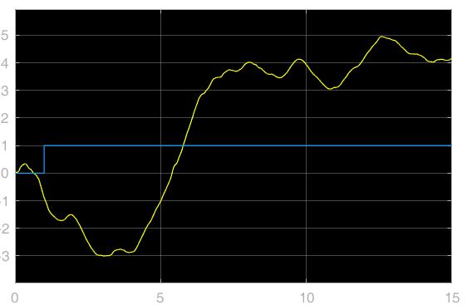
U-model control output (unstable)
output
reference
Joint 1
Joint 2

Slide 6
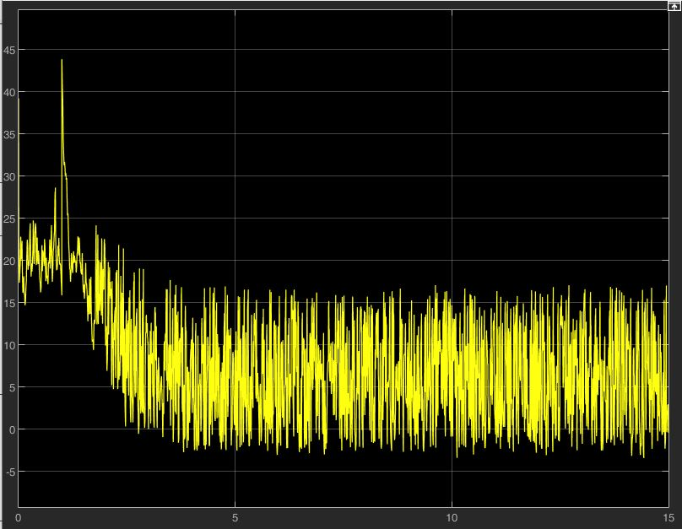
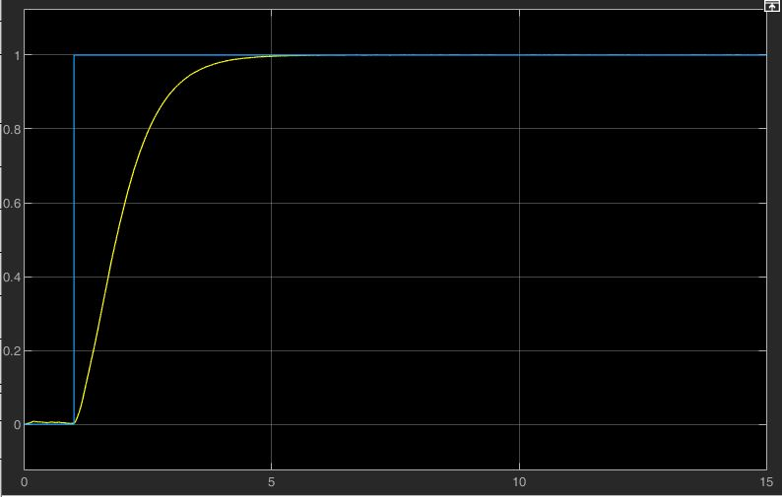
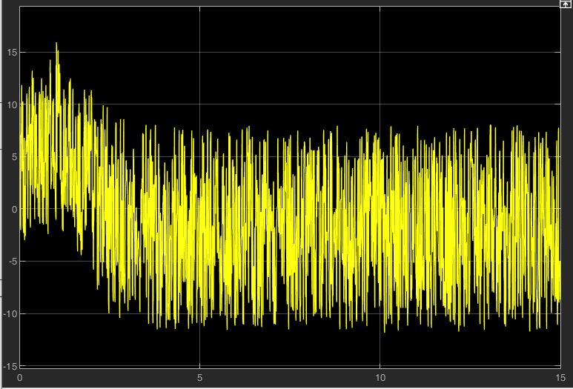
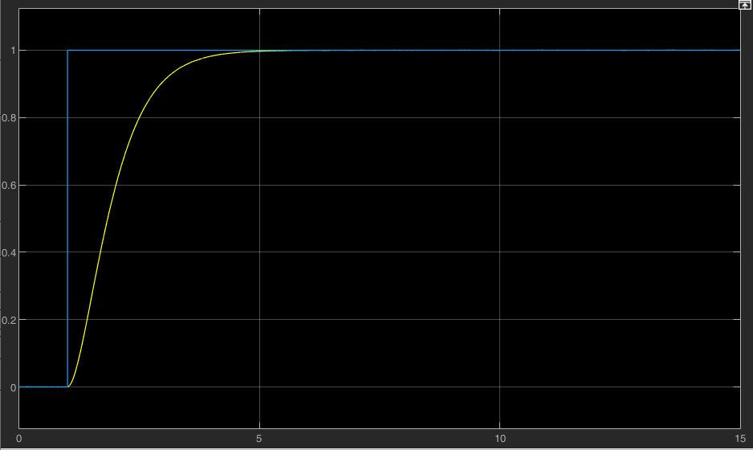
Control output (N*m)
angle output (rad)
USMC
reference
Joint 1
Joint 2

Slide 7
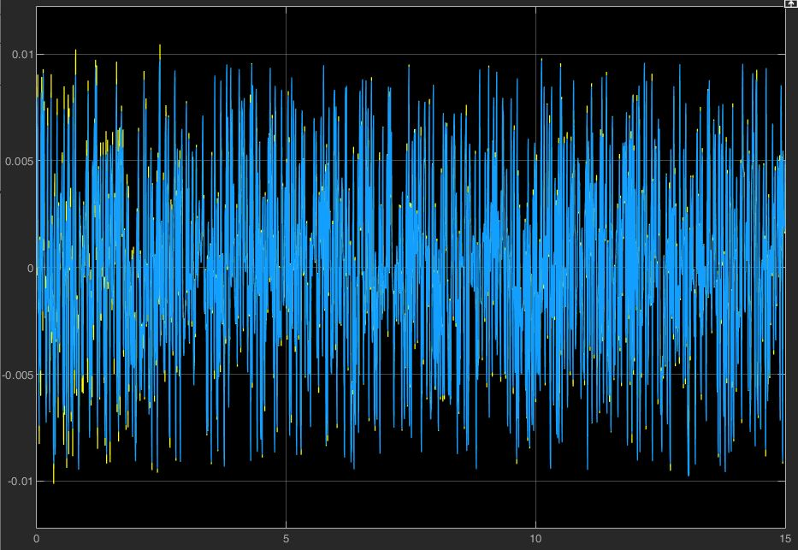
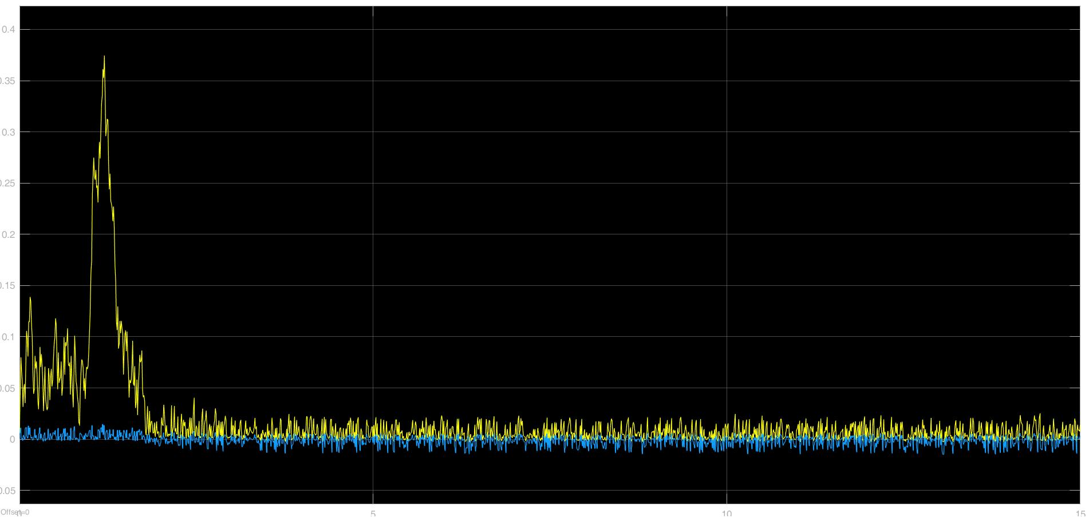
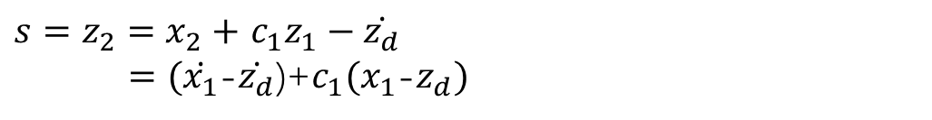
Sliding Variable
Joint 1
$s=z_{2}=$ $x_{2}+$ $c_{1}z_{1}−\dot{z_{d}}$
$=(\dot{x_{1}}$-$\dot{z_{d}}$)+${c_{1}(x}_{1}$-$z_{d})$
Joint 2
SMC
USMC

